Slide 1




The islands’ case for the post -2020 cohesion policy
Laboratory for Local and Insular Development
University of the Aegean - Greece
Pr. Ioannis Spilanis
CPMR Islands’ Commission
Gozo, 9/3/2017

Slide 2
Why islands are facing difficulties? (1)
The islands are territories with specific characteristics (size, population, fragility, remoteness, isolation) with impact to the production cost for business, for state (infrastructure and running costs) and cost of life for households .
“Traditional” attractiveness (i.e economies of scale, high connectivity etc) is not possible on islands
From the political recognition of islands’ specificity (PE, ECOSOC, CdR) to the legislation provisions:
  Article 170: TEN and islands
  Articles 174 & 175: specific territories
  Territorial Impact Assessment for modulating policies if they have outlier impact (definition?)
  The very partial application of the provisions

Slide 3
Why islands are facing difficulties? (2)
The European sectoral policies are without differentiation independently the territory p.ex. Policy of Concurrence
The islands are not integrated in the single market
As the island markets are small, there is no competition but monopoly or oligopoly situation
The non application of the principle of proportionality to face the fact that the application of european policies and the achievement of different goals costs more in islands
Integrated Island policy cannot be applied by national states as it “blocks” at the general provisions of EU legislation concerning crucial sectors as tax policy, transportation, concurrence policy etc

Slide 4
What has changed recently ?
After 2000
The new member states had lower GDP/capita; so islands became “richer” areas, so less “EU solidarity”
The EU overall policy has change the principle goal sifting from the cohesion to the external competitiveness
The crisis has reversed the cohesion trend.
The EU budget is not adapted to face cohesion problems . In the future, perhaps is going to be worse
But also political “fragilization” as nowadays more than the half of member states have no islands.
The importance of islands in Europe is decreasing

Slide 5
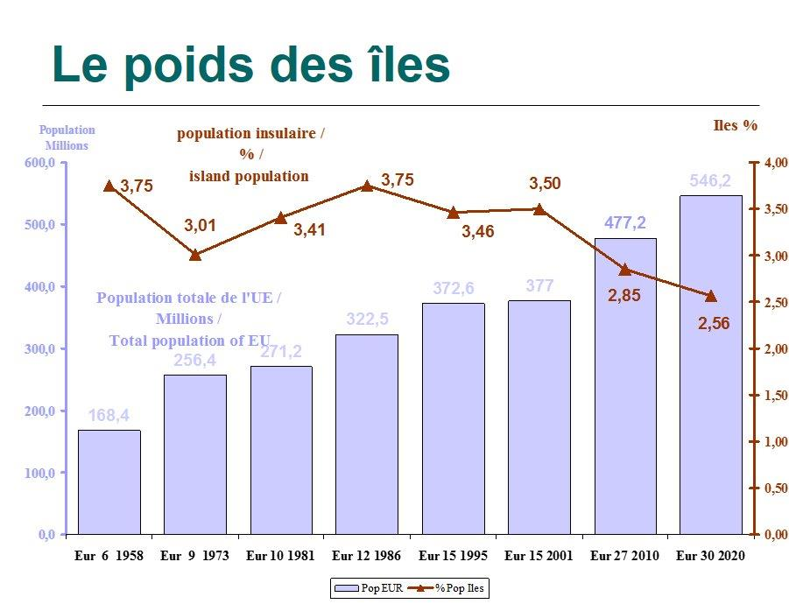
Islands have a decreasing importance
Consequently, find allies among the territories of art 174
Is perhaps necessary

Slide 6
The consequences on insularity
Low efficiency of island economy*
High fragility (mono-culture, “traditional & low added value activities based on nature’s exploitation)
Low Human Development and Social Progress Index
High level of unemployment, even if islanders use to migrate in difficult periods
Low level of skills as educated people has not the incentive to stay (low carrier opportunities)
Insularity has negative impact on attractiveness for business and people

Slide 7
Is there a solution?
Change the development model is order to achieve EU principles: Cohesion and Sustainability
+
Structural policies in order to ameliorate the attractiveness of specific regions (article 174) taking into account their specificities.
+
3 levels of policy (subsidiarity principle):
European: modulated sectoral policies in order to take into account territorial specificities + cohesion policy – solidarity principle;
National: big interregional projects, policies out of EU competences,
Regional: application of development policy

Slide 8
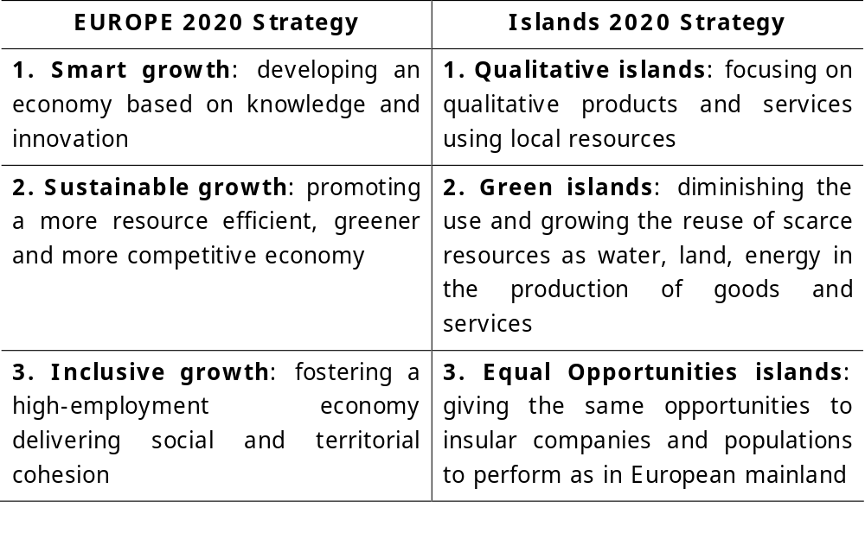
Islands’ strategy within a European perspective

Slide 9
European Policies for Territorial Cohesion (1)
A- Governance for better coordination of existing policies at the territorial level
Integrated development plans using all financial tools – special provisions for islands
Territorial Impact Assessment of EU policies with focus on specific territories – EUROSTAT /TERCET
Intra-Commission Service for monitoring achievements of territorial cohesion goals (areas art. 174) within SDG
Criteria for funds allocation based on different Indexes as RCI, HDI, SP in order to achieve SDG and not GDP

Slide 10
European Policies for Territorial Cohesion (2)
B – Adaptation of EU sectoral policies to the needs of territorial specific areas
Where specific provisions have to be taken at the european level, as:
Transport policy
Energy policy
Environmental Policy
Rural Development Policy
State aid Policy
Tax policy

Slide 11
European Policies for Territorial Cohesion (3)
C – Compensation of insularity over-cost
mainly for:
Creation and operation of General Interest Services (economic and non-economic)
Creation and operation of small innovative enterprises
Creation of networks supporting competitiveness of islands’ SME
Training and Lifelong Education
Application of european legislation
using financial tools adapted to islands’ administrative particularities

Slide 12
Thank you for your attention
Laboratory for Local and Insular Development
University of the Aegean - Greece
Pr. Ioannis Spilanis
ispil@aegean.gr

Slide 13
GDP evolution in islands 1993-2014 (EU -100)

Slide 14
Unemployment evolution 1993-2015

Slide 15
Ranking of Island regions to total EU regions*
Indexes | HDI | Social Progress index | Opportunity sub -index | Early | % unemployment | % Employment rate | GDP / capita 2007 | GDP/ capita 2014
Ionian isl | 203 | 241 | 253 | 198 | 231 | 221 | 204 | 218
V. Aigaio | 219 | 198 | 217 | 217 | 242 | 247 | 218 | 241
N. Aigaio | 210 | 242 | 255 | 222 | 240 | 237 | 140 | 174
Kriti | 204 | 195 | 210 | 211 | 254 | 240 | 178 | 226
Baleares | 182 | 174 | 174 | 256 | 249 | 195 | 73 | 116
Canarias | 208 | 164 | 183 | 253 | 269 | 260 | 149 | 181
Corse | 150 | 181 | 175 |  | 202 | 199 | 175 | 138
Guadeloupe | 256 | 166 | 223 |  | 256 | 254 | 196 | 200
Martinique | 237 | 153 | 208 |  | 251 | 243 | 202 | 186
Reunion | 257 | 165 | 227 |  | 264 | 265 | 225 | 211
Sicilia | 258 | 259 | 265 | 248 | 241 | 274 | 220 | 230
Sardinia | 224 | 203 | 234 | 246 | 228 | 261 | 192 | 204
Acores | 240 | 240 | 238 | 259 | 225 | 226 | 215 | 207
Madeira | 222 | 208 | 233 | 252 | 232 | 217 | 138 | 202
Aland | 1 | 4 | 9 |  | 33 | 1 | 21 | 28
Cyprus | 136 | 207 | 181 | 109 | 221 | 168 | 147 | 167
Malta | 175 | 199 | 163 | 240 | 77 | 194 | 195 | 154

