Slide 1
Towards a Zero Waste Islands Programme?
Ferran Rosa, Policy Officer

Slide 2
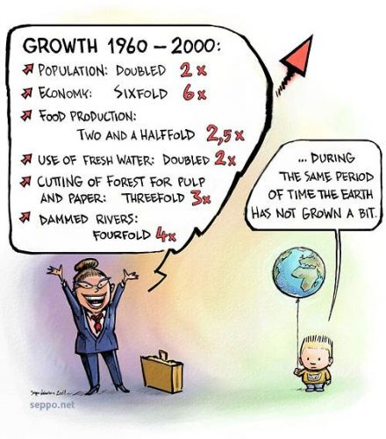
What’s Zero Waste?
“Zero Waste is a goal that is both pragmatic and visionary, to guide people to emulate sustainable natural cycles, where all discarded materials are resources for others to use. It means designing and managing products and processes to reduce the volume and toxicity of waste and materials, conserve and recover all resources, and not burn or bury them.”
Sources: Seppo.net and Zero Waste International Alliance

Slide 3
Four principles
Minimize residual waste
  Organic waste
  Separate collection
  Reuse
Make waste visible to re-think it
End up with superfluous waste
Citizen engagement

Slide 4
Challenges for small islands
Cost of shipment
Limited treatment facilities
Tourism
Limited HR at local governments
Need of systems that are
simple, cheap and local

Slide 5
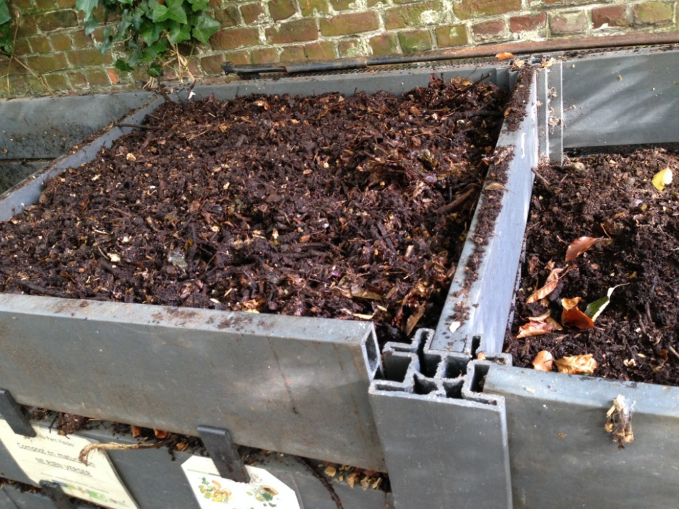
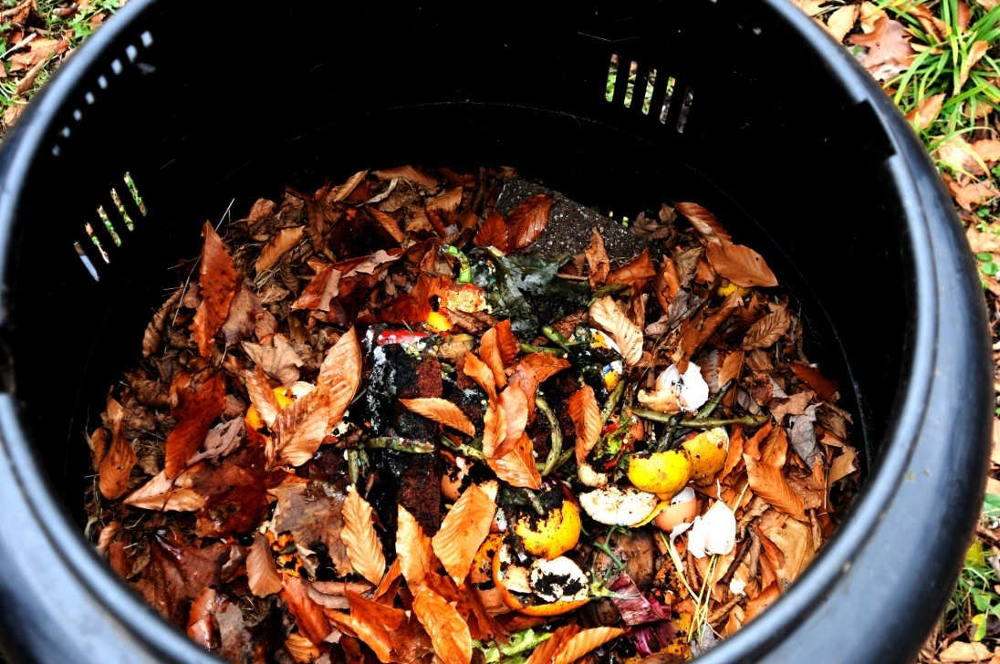
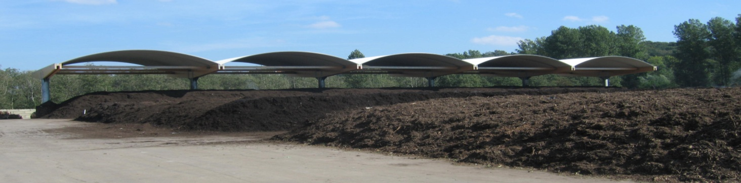
Fundamental: biodegradables
Majority of waste
Can be treated locally
Problematic if not treated
For small islands, it may be worth to maximise compost including paper & cardboard.
Photo sources: Shutterstock, Sylvie Loicq & Joan Marc Simon

Slide 6
Dry recyclables
Ensuring good capture
Maximise local use of them (mostly glass & wood)
Stocking those materials requiring shipment:
  Clean
  Compacted (mostly for plastics)

Slide 7
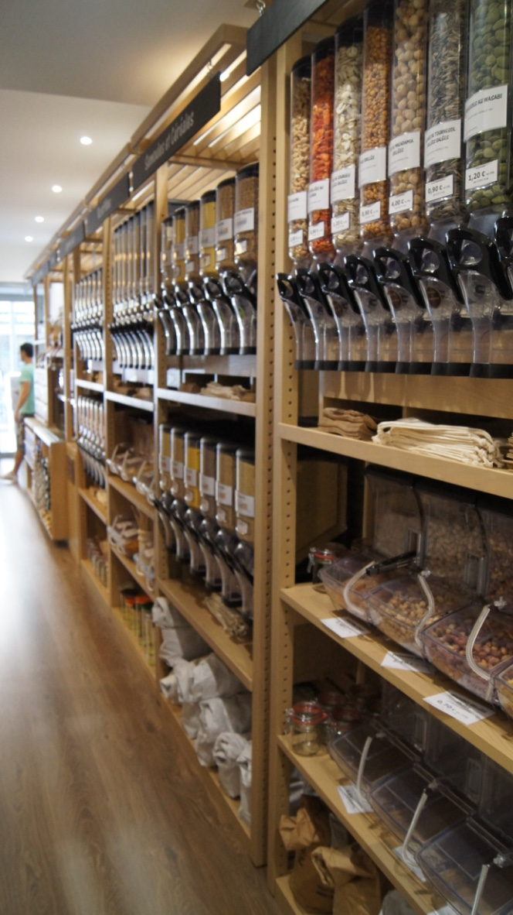
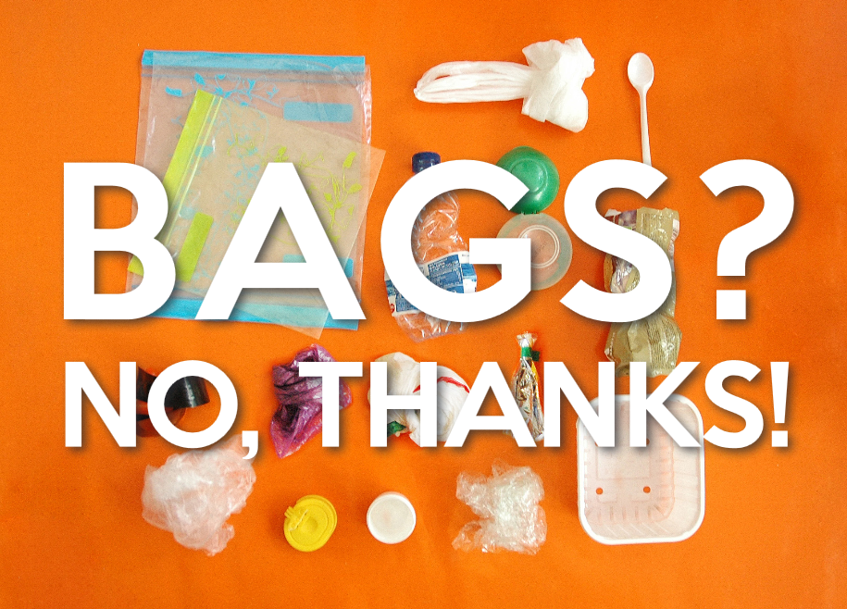
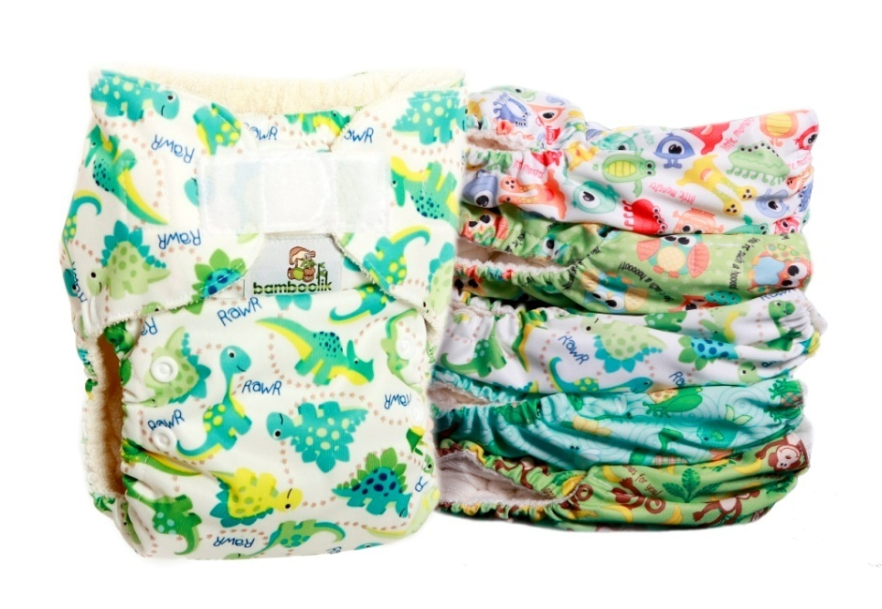
Non-recyclables & prevention
Stabilization on the island
Address these products directly
  Discouraging their use
  Taxes
  Bans

Slide 8




Citizen engagement
Making citizens part of the transition towards zero waste:
Zero Waste challenges
Repair and reuse activities
Sharing economy

Slide 9
Far, but not impossible
Identify problems
Engage with citizens
Set goals & calendarize activities
Commit to improvement

Slide 10
Contact
Thank you
for your attention!
Ferran Rosa
Policy Officer
Zero Waste Europe
ferran@zerowasteeurope.eu

