Slide 1
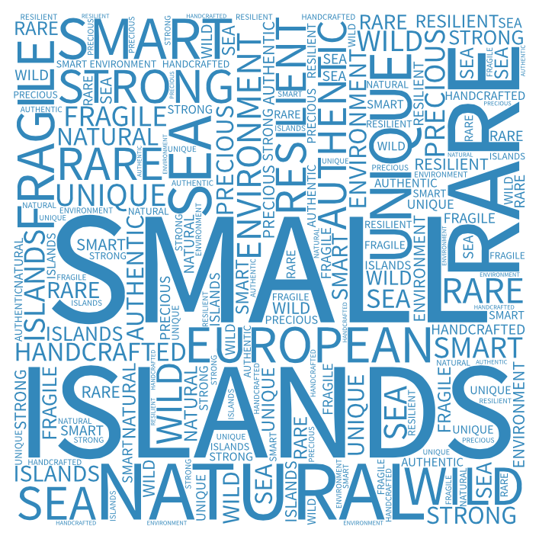



The sustainability of the Small Islands of Europe
A conference for the 16th ESIN Annual Meeting
EESC, Brussels
Tuesday 27th September 2016

Slide 2

ESIN members:
Organisational Capacity
Opportunities and Challenges
Brussels, EESC, 27 September 2016

Slide 3

Företagsam Skärgård
55 inhabited islands in 6 municipalities
One part time development officer
Voluntary board
Funded by Åland Government, project funding and members’ contributions.

Slide 4
Opportunities
Sustainable tourism development i e pilgrims, bird watchers, outdoors
New businesses: small scale industry, processing raw products into exclusive products and brands
The benefits of small-scale societies with fairly good finances

Slide 5
Challenges
Migration of young people
Big seasonal differences in population numbers
Sea transport system development
Environmental threats (eutrofication of the sea, overgrowth of landscape)
Municipality reform

Slide 6


OTOČNI SABOR-Association for the development of Croatian islands
NGO with membership on all 47 inhabited islands in Croatia (out of 78 islands and 524 islets)
spread over 7 coastal and island counties, 51 island cities and municipalities
Areas of interest: Agriculture and Rural Development,
Transport, Regional policy, Fisheries and Aquaculture
Promotes island cooperation and development, protection of the environment, engagement with local and government authorities

Slide 7
Opportunities
Enormous development potential
Traditional activities of Shipping, shipbuilding and stone carving balance over-reliance on tourism
Islanders’ interest for sustainable development

Slide 8
Challenges
Agriculture in decline
Poor economic structure: Island GDP is 2% of the Croatian GDP
Over-dependence on Tourism
Decision making processes are in the hand of business interests
Lack of water supply on the islands affecting competitiveness of island businesses (extra costs)

Slide 9


Association of
Small Danish Islands
27 island members across 19 local municipalities
Secretariat with 2 employees
Voluntary board of islanders
Funded by Danish Government, members’ contributions and project funding

Slide 10
Opportunities
Nature: The value and attraction of coastal nature and the sea
Tourism: The islands provide a large potential for sustainable tourism
Slow-living: Island life offers an alternative to busy city life

Slide 11
Challenges
Lack of good broadband mobile infrastructure is a hurdle for new enterprises and settlement
Lack of rental housing is a big problem that results in loss of potential new inhabitants
Level of ferry services are very different from island to island and is often very poor (limited timetable) and expensive

Slide 12


Association of Estonian Islands (EIA)
19 islands members across Estonia
All work is done on a voluntary basis
Leading board (3 members), Supporting board (15 members)
Funded by members’ contributions and project funding.
www.saared.ee

Slide 13
Opportunities
Nature and culture– Value of unique and interesting environment on every island.
Local resources – Renewable energy
Islands’ supporting group in the Parliament

Slide 14
Challenges
The main aim of the EIA is to help populated islands to remain populated. Especially young people.
Strenghtening islands cultural identity
Influencing policies and rules by increasing their awareness and understanding of small islands

Slide 15


Finlands Öar RF – Suomen Saaret RY
Local communities, associations and private members
At the moment two project officers
Voluntary board
Funded by project funding and members’ contributions.

Slide 16
Opportunities
Natural resources: the archipelago with the highest amount of islands in the world, unexploited nature, silence – gives almost unlimited tourism opportunities
Highly developed infrastructure (an extensive free ferry network, functioning internet in almost all parts of the archipelago) – flexible working
Part time residents brings economic stability to many entrepreneurs

Slide 17
Challenges
Depopulation – there is a threat of decreasing services (health care, schools, elderly care, etc)
Lack of working opportunities for new islanders – you must be able to create your own job
Lack of houses for rent

Slide 18



Association of the Ponant Islands
15 islands and 18 communes
16 000 inhabitants with 2 M visitors/year
Spread across 4 regions and 6 ‘departements ’
Voluntary board, 1 director and 3 part time employees
funding from communes and regions

Slide 19
Opportunities
High environmental quality and biodiversity
Quality Heritage resource
Emerging new entrepreneurs
Special contract for medical services
New yearly island festival connecting all 15 islands
Energy transition with solar and tidal energy – new innovative Sabella tidal turbine

Slide 20
Challenges
Fragile economy dominated by tourism, with fishing and farming decreasing
Land pressure from second homes & limited opportunity for expansion= high housing cost for islanders
High fragility of environment (waste/water)
Difficult to maintain essential services
40% higher cost than mainland due to transport and port infrastructure

Slide 21


Hellenic Small Islands Network
50 islands members across 30 local authority areas
2 part time officers (1 Director, 1 Treasurer)
Voluntary board (7 board members)
Consultants (3 consultants companies)
Funded by project funding and members’ contributions.
flag

Slide 22
Opportunities
Natural resources: wind power and other renewables provide low carbon electricity and funding for local projects
High quality tourism (elderly care/ disabilities etc)
Islands are a powerful pole/ factor for the productive reconstruction of country (eg: island product branding, etc)
Unexploited potential of marine and submarine island area
flag

Slide 23
Challenges
Lack of good condition and good quality connectivity (coastal ships, coastal materials and data)
Many challenges in terms of waste, water supply, energy and services
Many issues with sewerage and land-planning
flag

Slide 24


Comhdháil Olieáin Na hÉireann
(Ireland’s island Federation)
22 Islands in 4 local authority areas
No core funding: only financial support by Government is towards Comhdháil AGM
Voluntary Board of management
No staff :Board members volunteer their time
State agency representatives needed on the Board

Slide 25


Opportunities
Farming schemes for Islands
Nation-wide Island Health consultation
Tourism: Wild Atlantic Way as new tourism stream
Broadband consultation
Subsidised transport
Primary & Secondary Education

Slide 26
Challenges
No Islands LEADER funding
No Core Funding for Islands Federation
Decreasing Population
Lack of Island’s Minister
No Statutory based Island Group
Cost of Living
Decreased funding for Island development companies & co-ops

Slide 27


ANCIM: Associazione Nazionale Comuni Isole Minori
36 communes (220 000 people) across 7 regions
3 office bearers, 1 secretary and a committee of 12 representatives

Slide 28
Opportunities
Education: one High school specialised in the field of energy, another in European culture
National law for the islands ready for implementation
Island food production labelling
Tourism
Your logo

Slide 29
Challenges
Transport and territorial continuity
Health and education
Energy
Not enough appreciation of island culture and traditional activities
Need for positive discrimination in favour of islands
Your logo

Slide 30


Scottish Islands Federation
16 islands members across 6 local authority areas
Voluntary board of 6 members
One part time development officer
Funded by Scottish Government, project funding and members’ contributions

Slide 31
Opportunities
Natural resources: wind power and other renewables provide low carbon electricity and funding for local projects
New subsidised transport scheme: Road Equivalent Tariff
Health and social care – Small Isles pioneering solution: community first responders and trained community health and social care workers work with a regular visiting GP service
Community land and asset ownership: islands can have more control over their development

Slide 32
Challenges
Lack of connection to mainland grid constrains the Renewable Energy sector development
Employment: island employment is often lower paid and is combined with a higher cost of living; good broadband and suitable premises are required to stimulate entrepreneurial self-employment
Lack of affordable housing (competition from holiday/second home market) combined with fuel poverty
Tourism is a main income generator but brings many challenges in terms of waste, housing and infrastructure (roads, facilities etc)

Slide 33


National Association for the Swedish archipelago
15 regional organizations across the country
Two persons part-time
Voluntary board of islanders
Funded by Swedish Government, project funding and member fees
Insert Your logo here
Insert your Country’s flag here

Slide 34
Opportunities
Local resources, local people, nature and culture
The expansion of broadband
Part time residents, tourism
Insert your Country’s flag here
Insert Your logo here

Slide 35
Challenges
Work opportunities, preserve existing and create new
Housing and Population, lack of housing, reversed population pyramid
Service, deregulated utilities
Insert your Country’s flag here
Insert Your logo here

