Slide 1
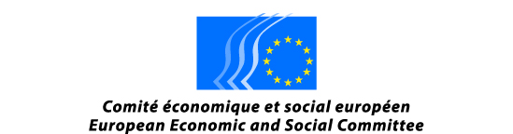

Towards Zero Waste Islands
Integrated Assessment of Systems in Small Islands:
The Case of the Greek Islands
Prof. Christopher J. Koroneos
Mayor of Nisyros Island
Greece

Slide 2
Greek Islands are a characteristic region
Islands have specific characteristics:
  Small size (limited population, area, natural resources)
  Remoteness and isolation
  Particular, rich and vulnerable natural and cultural environment
Insularity influences negatively production and living cost. Islands –compared to the mainland- cannot have
  economies of scale due to limited variety and quantity of resources
  good accessibility and low transport cost
  agglomeration externalities
Insularity has to be considered as a permanent, natural feature that affects negatively the islands’ attractiveness, directly and indirectly.
Insularity may place obstacles for the achievement of the goal of sustainable development.
Insularity creates unequal opportunities between the small Greek Islands and the rest of the European Union.
EU and Greece must apply a policy that addresses the Insularity issue.

Slide 3
Greek Islands are a characteristic region
The performance of the islands is generally lagging behind EU-27 considering most of the key development indicators; this low performance may be attributed to lack of resources
Islands’ attractiveness is directly influenced by insularity: low Accessibility, low quality and high cost Public Interest Services, low external economies.
Lisbon’s strategy goals are not met in islands by far (% of employment, R&D expenditure, education attainment, ITC penetration, resource efficiency etc), obstacle for development.
Vulnerability is a characteristic of islands’ economy (mono-activity/tourism – public intervention) and environment (low availability of resources – fragility)
Attractiveness and performance is even lower for the small islands: vulnerability is higher
Natural and cultural assets constitute a prominent potential for a significant number of islands.

Slide 4
Greek Islands are a characteristic region
The major problems that the Greek Islands face because of their insularity are:
  Difficulty in transportation
  Lack of fresh water – Desalination is used in many islands – necessary but very high energy intensive –Bottled water is imported Access to energy sources – Oil is used today for the production of electricity and transportation within the Islands
  Waste water treatment – There are no waste water treatment plants
  Solid Waste management – There are no sustainable management methods applied in any of the islands
  High environmental costs
IT IS OF UTTERMOST IMPORTANCE TO INTEGRATE ALL THESE ISSUES
TO ATTAIN BETTER PERFORMANCE AND LOW ENVIRONMENTAL COSTS

Slide 5
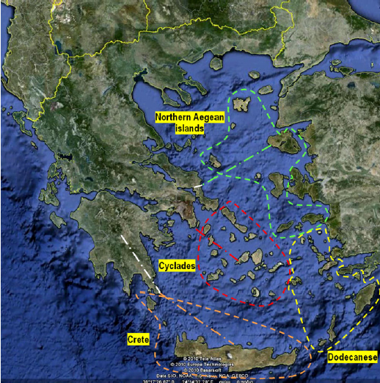
The Energy State of the Greek Islands
Island interconnection to the mainland:
Cyclades (2015)
North Aegean (2019)
Crete (2020)

Slide 6
In order to tackle the Energy Supply Issue it is Necessary to Build Energy Scenarios
Technology options
Wind parks
Photovoltaics
Thermal Solar
Concentrated Solar
Geothermal
Uncertainties
Economic growth
Technological development
Fuel cost
Public acceptance
International climate policies etc.
Scenarios
Futures
Strategies

Slide 7
Greek Islands are a characteristic region
The scenario that will be used is the replacement of all energy use by Renewable Energy Sources (RES). Solar Energy, Wind Energy and Geothermal Energy (Medium and Low enthalpy) will be utilized.
RES will be used for the production of electricity, water heating, fresh water production, waste water treatment and solid waste management.
FRESH WATER SUPPLY
Most of the islands do not have natural water. This problem was resolved until recently with the transportation of water. This was a very expensive method. In the past few years desalination has been used. This is an extremely energy intensive method for the production of water.
Most of the small Greek Islands today use desalination for their water needs. However, the water produced using desalination has a very high concentration of Total Dissolved Solids (TDS) so it can not be used for drinking.

Slide 8
Greek Islands are a characteristic region
This leads to the consumption of bottled water which is imported mainly from the Greek mainland.
The production and transportation of the bottled water has a very big environmental impact.
This also creates a big solid waste problem from the plastic bottles that are used.
It is very important that the policy of the federal government and the local authorities use an INTEGRATED MODEL that interconnects the energy use and the production of fresh water with:
      Access to energy sources
      Waste water treatment
      Solid Waste management
      Environmental costs

Slide 9
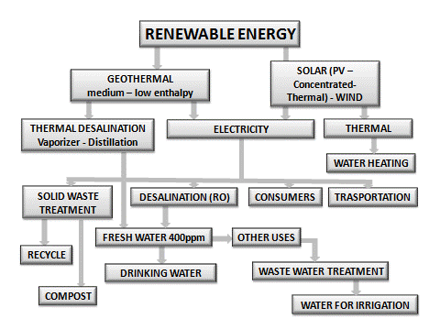
INTEGRATED MODEL

Slide 10
Energy and Emissions Savings
Two examples of CO2 emissions savings and energy savings are listed below:
Producing electricity from Renewable Energy Sources (Solar, Wind, Geothermal [Medium Enthalpy] saves 18 tons of CO2/MWe emitted from the electricity production from oil and 0,28 tons Sox/MWe.
Drinking water production eliminates plastic bottles and leads to the following savings:
  Plastic bottles manufacturing: 4.0MJth/L (0.39kWhe/L) of energy.
  Water treatment at bottle plant: between 0.0001–0.02 MJth/L (0.002kWhe/L), filling operations up to 0.01MJth/L (0.001kWhe/L, transportation between 1.4 and 5.8 MJth/L (0.14–0.56 kWhe/L) and cooling between 0.2 (0.019 kWhe/L) and 0.4 MJth/L (0.039 kWhe/L) respectively.

Slide 11
Desalination Technologies
The Desalination Technologies shown in the model are the following:
Mechanical Operations (Reverse Osmosis [RO])
Thermal Operations
  Distillation
  Multistage flash (MSF)
  Multiple effect distillation (MED)
  Vapor compression
Electro dialysis
Vacuum freezing
The RO Desalination processes utilizes 15 kwh /m3 of fresh water.
Renewable energy sources such as solar energy, wind energy and Geothermal Energy must be utilized to reduce the cost and the environmental impact of fresh water produced by desalination.

Slide 12
Meditarrean Strategy
For Sustainable Development
The MEDITERRANEAN STRATEGY FOR SUSTAINABLE DEVELOPMENT has an important component, the development of synergies to enhance the process of implementing global Conventions, including the UN Framework Convention on Climate Change and its Kyoto Protocol, the Convention on Biological Diversity, the Convention to Combat Desertification and the UN Convention on the Law of the Sea, in relation with the Barcelona Convention and other relevant regional instruments.
The seven interdependent priority fields of action and synergy shown below are essential for the sustainable development of the small Islands
  better management of water resources and demand;
  improved rational use of energy, increased renewable energy use and mitigation of and adaptation to climate change
  sustainable mobility through appropriate transport management
  sustainable tourism as a leading economic sector
  sustainable agriculture and rural development
  sustainable urban development
  sustainable management of the sea, coastal areas and marine resources.

Slide 13
Conclusions
Small Islands can become independent and self sufficient in their energy use with the utilization of Renewable Energy Sources.
This will lead to a paradigm for a new model of development and circular economy.
This can be done by the application of an integrated model by the federal government and the local authorities that interconnects
    Access to energy sources
    Fresh water production
    Waste water treatment
    Solid Waste management
    Environmental costs

